Slide 1

Insider Data Breach: A Forensic Investigation
Presented by:
Umar Tariq 2022604
M Zeeshan 2022644
Abdur Rehman 2022299
Ahmad Amjad 2022063
Notes:
1

Slide 2
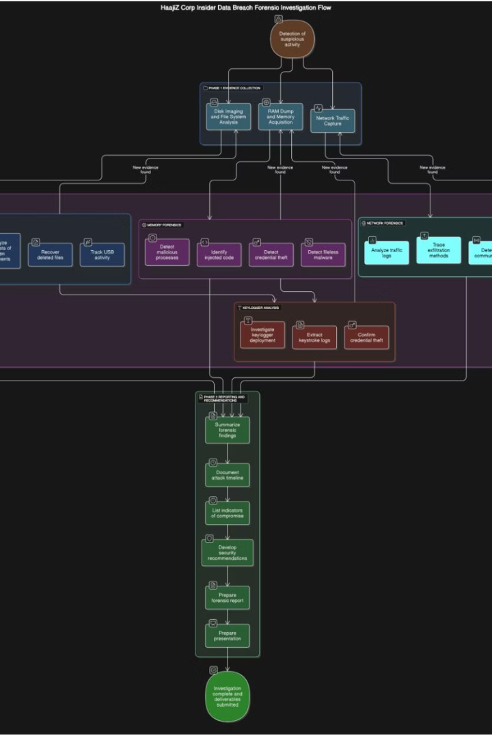

Problem Statement and Objectives
Problem
Insider threat via Dow (Formbook) malware caused data breach.
Objectives
Collect and secure digital evidence
Perform advanced forensic analysis
Detect keylogger and malware
Develop forensic report and recommendations
Notes:
2

Slide 3

Demonstration of the Working System
Evidence Collection
Malware Detection
Disk imaging, memory dumps, and network logs acquired.
Dow.exe process found running stealthily in memory.
Notes:
3

Slide 4

Implementation
1
Disk Imaging & File Recovery
2
Memory Analysis
Used Volatility Framework to detect injected malware processes.
Recovered deleted client files indicating data exfiltration.
3
Network Analysis
Captured HTTP traffic showing malware download and C2 communication.
Notes:
4

Slide 5
Challenges Faced
Stealth Malware
Encrypted Traffic
Fileless malware operating entirely in memory.
Malware used HTTP to evade detection.
Notes:
5

Slide 6




Visual Aids: Forensic Analysis
Disk Imaging
Recovered deleted files from USB and hard drive.
Memory Dump
Identified malicious dow.exe process in memory.
Network Capture
Tracked malware download and encrypted data exfiltration.
Notes:
6

Slide 7

Lessons Learned
Accidental Infection
Importance of EDR
Malware likely downloaded via malicious redirection link.
Endpoint detection and response tools are critical.
Employee Training
Phishing and social engineering awareness is essential.
Notes:
7

Slide 8

Next Steps and Recommendations
Deploy HIDS and EDR
Enforce Least Privilege
Enhance endpoint security and monitoring.
Limit user access to reduce insider risks.
Implement Web Filtering
Regular Training
Block malicious redirects and suspicious sites.
Educate employees on phishing and social engineering.
Notes:
8

Slide 9


